Slide 1
Data Stuctures and Algorithms
Dr. Fidaa Abed

Slide 2
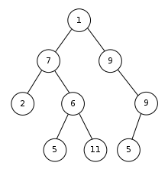
Binary Trees
A data structure
We have nodes
Each node has a maximum of two children
Left child
Right child

Slide 3
Binary Trees
Node 1 is the root node
The nodes that have no children are called leaf nodes
Node 2, 5, 11, and 5 are leaf nodes

Slide 4
Binary Trees
Size of the tree is the number of nodes in the tree
In this example the size is 9

Slide 5
Binary Trees
Height of a node is the length of the longest
path to the leaf nodes
Height of node 7 is 2
Height of the binary tree is the height of
its root

Slide 6
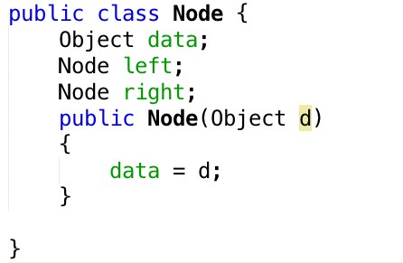
Node

Slide 7

Binary Tree

Slide 8
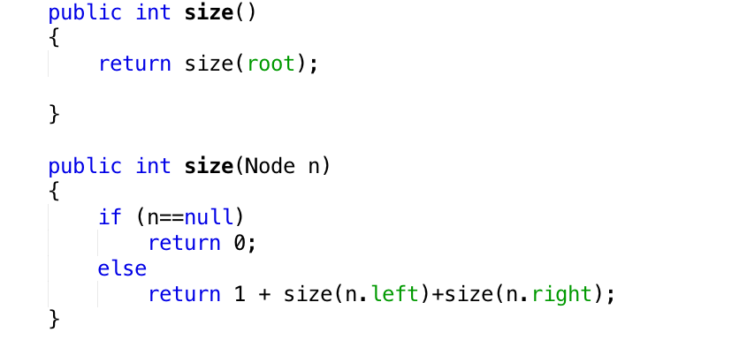
size()

Slide 9
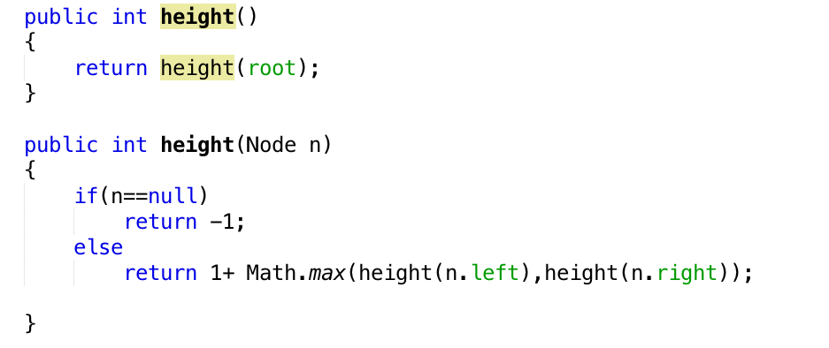
height()

Slide 10
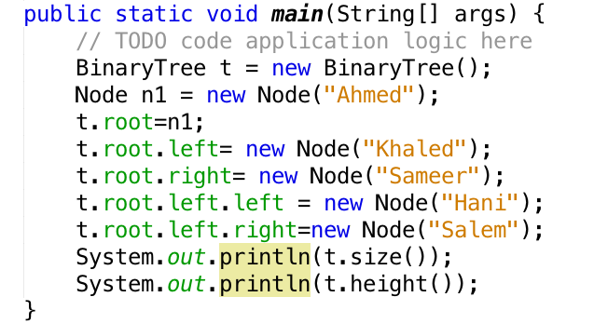

Sample tree

Slide 11
Excercise
Implement a binary tree including size and height methods then test the implementation by creating a tree.
Add a recursive method to print all the nodes’ data

